Slide 1
Pharmacologic and Surgical Approaches to Obesity

Slide 2
Learning Objectives
Understand and be able to explain the physiological basis of the anti-obesity drugs orlistat, liragutide, phentermine/topiramate, lorcaserin and naltrexone/bupriopion.
Predict some potential side effects of these drugs based on their mechanism of action
Evaluate the potential of exercise mimetics and other energy-expenditure increasing therapies.
Explain the differences between Roux en-Y, Gastric Banding and Sleeve Gastrectomy.
Contrast the effectiveness of surgical approaches to pharmacological approaches to obesity.
Consider the differences in accessibility and outcomes for surgical approaches to obesity.

Slide 3
Obesity Pharmacotherapy
Drugs intended to reduce obesity
All either reduce energy intake or reduce energy expenditure
Drugs intended to reduce obesity consequences
Hyperlipidemia -> Statins
Diabetes/Insulin Resistance -> Insulin, Metformin, GLP1 agonists, TZDs
High Blood Pressure -> Beta-Blockers, Angiotensin Receptor Blockers (ARBs)
Liver Disease -> Nothing

Slide 4
Design a drug exercise
For weight loss would you rather design a drug that:
Reduced appetite
Reduced absorption
Increased energy expenditure
Think of a pathway or mechanism that we have learned about and how a drug could help. Be as specific as possible!

Slide 5
Some Anti-Obesity Drugs
Drug | FDA Approval | Mechanism of Action
Orlistat (Xenical) | 1999 | Lipase inhibitor, reduces fat adsorption
Liraglutide (Saxenda/Victoza) | 2017 | GLP-1 agonist, reduces hunger and gastric emptying, improves insulin responsiveness
Phentermine/Topiramate (Qysmia) | 2012 | Fen-Fen
Lorcaserin (Belviq) | 2012
Naltrexone/Bupropion (Contrave) | 2014
Dinitrophenol | 1890s-1938 (formation of FDA) | Increased heat production (energy expenditure)

Slide 6
Dinitrophenol
Chemical uncoupler
Energy (heat) from digestion is generated
Rather than used to make ATP the proton gradient is released
Heat is generated as a biproduct
Very effective, also causes hyperthermic death

Slide 7
Orlistat

Slide 8
Who do you think orlistat might be the most effective for?
Individuals who eat when stressed
Individuals who eat a high calorie diet with lots of fat
Individuals who have food cravings
Individuals who have a lower metabolic rate
Individuals who have problems feeling full
What do you think a side effect of orlistat might be?
Notes:
~35% dropouts in the trials, introducing some selection bias
In the wild, in a Canadian population only 2% continued taking the drug by two years

Slide 9
Overview of Appetitive Targets

Slide 10
Liraglutide, a GLP-1 (Glucagon-Like Peptide 1) Agonist
Other benefits of GLP1 agonists Also sold as Victoza
Reduced cardiovascular risk
Decreased glycemia
Similar mechanism of action to exendins (DPP4 inhibitors)
These drugs blocks the breakdown of endogenous GLP1
Examples include Sitagliptin (Januvia)

Slide 11
GLP-1 Agonists as anti-Obesity Drugs
Liragutide is a GLP-1 analog
Wadden TA, Hollander P, Klein S, Niswender K, Woo V, Hale PM, Aronne L. Weight maintenance and additional weight loss with liraglutide after low-calorie-diet-induced weight loss: The SCALE Maintenance randomized study. Int J Obes. Nature Publishing Group; 2013; 37: 1443–51. doi: 10.1038/ijo.2013.120.

Slide 12
Who do you think liraglutide might be the most effective for?
Individuals who eat when stressed
Individuals who eat a high calorie diet with lots of fat
Individuals who have food cravings
Individuals who have a lower metabolic rate
Individuals who have problems feeling full

Slide 13
Phentermine and Topiramate
Phentermine is an amphetamine
Causes release of noradenaline into synapses (SNS activator)
Immediate actions
May increase energy expenditure
Taken in the 70s as fenfluramine-phentermine, also known as fen-phen
Approved 1970s-1997
Pulled for valvulopathies and pulmonary hypertension
Topiramate is an anticonvulsant with anti-obesity side effects
May enhance satiety long-term

Slide 14
Effectiveness of Phentermine/Topiramate
Allison DB, Gadde KM, Garvey WT, Peterson CA, Schwiers ML, Najarian T, Tam PY, Troupin B, Day WW. Controlled-Release Phentermine/Topiramate in Severely Obese Adults: A Randomized Controlled Trial (EQUIP). Obesity. Nature Publishing Group; 2012; 20: 330–42. doi: 10.1038/oby.2011.330.

Slide 15
Who do you think phentermine/topiramate might be the most effective for?
Individuals who eat when stressed
Individuals who eat a high calorie diet with lots of fat
Individuals who have food cravings
Individuals who have a lower metabolic rate
Individuals who have problems feeling full

Slide 16
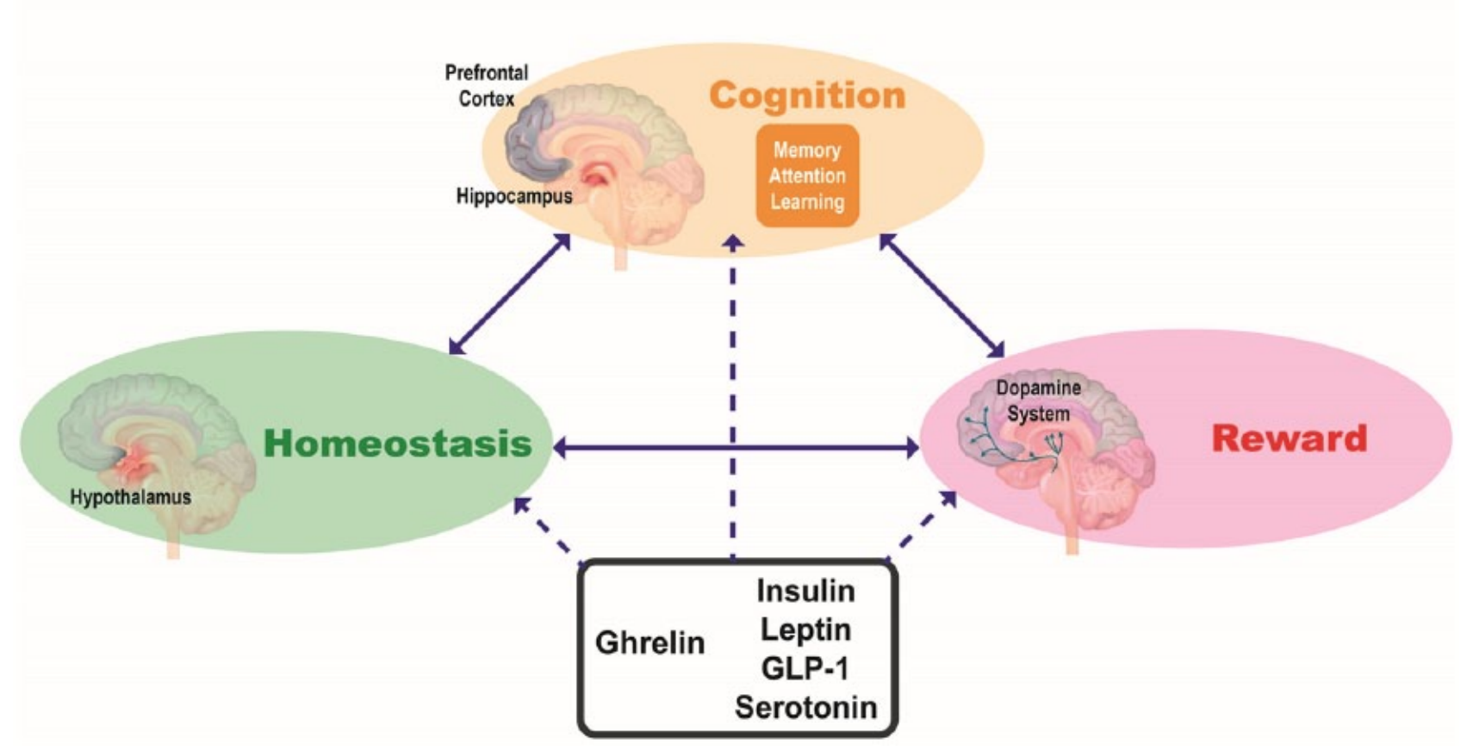
Moderating Food Reward
5HT2a is Serotonin Receptor
mu-Opioid Receptor is an Opiate Receptor

Slide 17
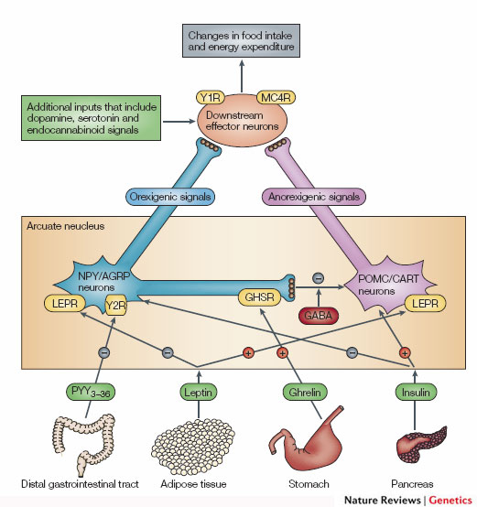
Lorcaserin (Belviq)
Lorcaserin
Serotonin Agonist (5-HT2C)
Modified version of fenfluramine
Activates POMC neurons
Also suppresses reward pathways
Promotes
Eating
Suppresses
Appetite
Notes:
Emerging reserarch about endocannabinoids and dopaminergics

Slide 18
Naltrexone/Bupropion (Contrave)
Naltrexone
Opioid Antagonist
Also prescribed for alcohol and opioid dependence
Suppresses food reward
Bupropion
Activates POMC neurons to suppress appetite
Antidepressant

Slide 19
Who do you think lorcaserin or naltrexone/bupropioin might be the most effective for?
Individuals who eat when stressed
Individuals who eat a high calorie diet with lots of fat
Individuals who have food cravings
Individuals who have a lower metabolic rate
Individuals who have problems feeling full

Slide 20
2-5% of obese individuals have a mutation in the MC4R. Based on what we have learned do you think Lorcaserin or Bupropion/Naltrexone would be effective in those patients?
I think it would work better in MC4R mutated individuals
I think it would work better in obese normotypes
I think it would work the same
Promotes
Eating
Suppresses
Appetite

Slide 21
Variable Effectiveness of Drugs in Individuals
Smith SR, Weissman NJ, Anderson CM, Sanchez M, Chuang E, Stubbe S, Bays H, Shanahan WR. Multicenter, Placebo-Controlled Trial of Lorcaserin for Weight Management. N Engl J Med. 2010; 363: 245–56. doi: 10.1056/NEJMoa0909809.

Slide 22
Approximate Effectiveness
Modified from Bray GA, Ryan DH. Update on obesity pharmacotherapy. Ann N Y Acad Sci. 2014; 1311: 1–13. doi: 10.1111/nyas.12328.

Slide 23
Effectiveness in context
Class 3 obesity (BMI is 40)
Average Male (177cm) -> 125 kg to be class 3
Average Female (162cm) -> 105 kg to be class 3
Average effectiveness is ~6kg
BMI now 37.7 (F)

Slide 24
Common Types of Bariatric Surgery

Slide 25
Current Indications for Bariatric Surgery
BMI > 40
BMI > 35 with one or more of
Diabetes
NAFLD
Hyperlipidemia
Heart Disease
Gastrointestinal disorders
Sleep apnea or other respiratory disorders
Data from American Society for Metabolic and Bariatric Surgery (www.asbms.org)
Notes:
158000 to 228000 (82% increase)

Slide 26
Effectiveness of Bariatric Surgery

Slide 27
Improved Health Outcomes Post Surgery
Glycemia
Medication Use
Quality of Life
Schauer, P. R., Mingrone, G., Ikramuddin, S. & Wolfe, B. Clinical outcomes of metabolic surgery: Efficacy of glycemic control, weight loss, and remission of diabetes. Diabetes Care 39, 902–911 (2016).

Slide 28
Why is this more effective?
Less energy intake
Less ingested
Less absorption
Less adaptive reductions in energy expenditure
Mechanisms proposed
GLP1
Microbiota/Bile Acid Signaling
BLC: Biggest Loser Competition
Knuth ND, Johannsen DL, Tamboli RA, Marks-Shulman PA, Huizenga R, Chen KY, Abumrad NN, Ravussin E, Hall KD. Metabolic adaptation following massive weight loss is related to the degree of energy imbalance and changes in circulating leptin. Obesity. 2014; 22: n/a-n/a. doi: 10.1002/oby.20900.

Slide 29
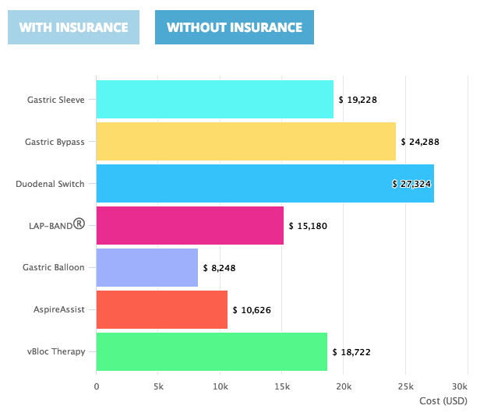
The costs of bariatric surgery
Estimated Annual Costs Pre-and Post-Surgery
Sussenbach SP, Padoin A V., Silva EN, Benzano D, Pufal MA, Barhouch AS, Chatkin R, Ramos RJ, Balestro A, Mottin CC. Economic benefits of bariatric surgery. Obes Surg. 2012; 22: 266–70. doi: 10.1007/s11695-011-0558-z.
https://www.bariatric-surgery-source.com/cost-bariatric-surgery.html

Slide 30
Bariatric surgery and mental health
US Average
10%
8%
1-5%
Dawes, A. J. et al. Mental health conditions among patients seeking and undergoing bariatric surgery a meta-analysis. JAMA - J. Am. Med. Assoc. 315, 150–163 (2016).

Slide 31
Learning Objectives
Understand and be able to explain the physiological basis of the anti-obesity drugs orlistat, liragutide, phentermine/topiramate, lorcaserin and naltrexone/bupriopion.
Predict some potential side effects of these drugs based on their mechanism of action
Evaluate the potential of exercise mimetics and other energy-expenditure increasing therapies.
Explain the differences between Roux en-Y, Gastric Banding and Sleeve Gastrectomy.
Contrast the effectiveness of surgical approaches to pharmacological approaches to obesity.
Consider the differences in accessibility and outcomes for surgical approaches to obesity.

